Slide 1

DriverPass System Analysis
Veronica Guzman
Notes:
[No speaker notes required for this slide.]

Slide 2

System Requirements
Functional Requirements:
User Authentication and Access Control: The system must authenticate users' identities and manage their access to functionalities and data based on assigned roles and permissions.
Data Handling and Storage Management: The system should enable users to perform operations like creating, reading, updating, and deleting data while ensuring its security, integrity, and proper storage in a designated repository.
Nonfunctional Requirements:
Performance Efficiency: The system must exhibit consistent and acceptable response times, ensuring smooth operation even during peak usage periods. For instance, specifying maximum response times for specific operations.
Robust Security Measures: The system should implement stringent security measures such as encryption, access controls, and protection against unauthorized access. This ensures confidentiality, integrity, and availability of both the system and its data.
Notes:
[In your speaker notes, include an explanation of the different requirements you determined for DriverPass’s system. What are the functional requirements you selected to describe? What are the nonfunctional requirements you selected to describe? Be sure to explain how these requirements meet DriverPass’s needs.]

Slide 3
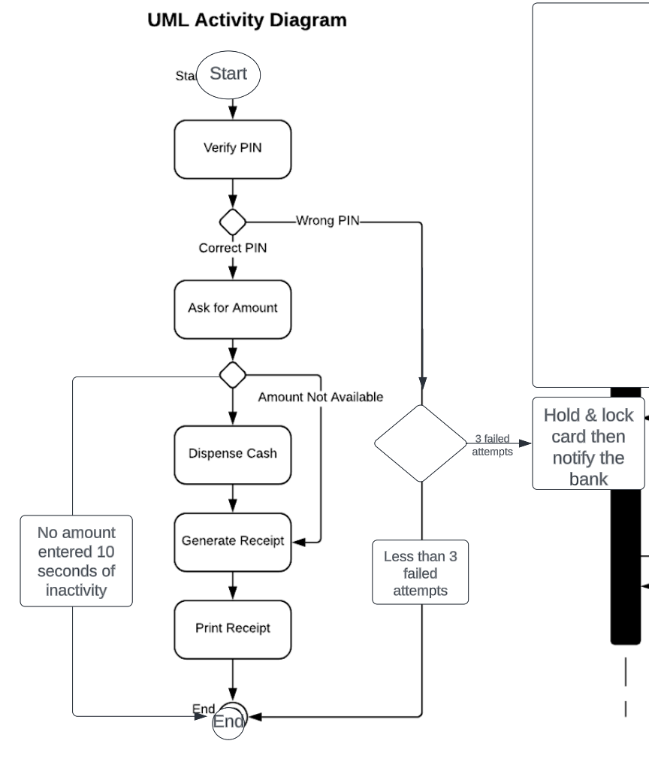
Use Case Diagram
Notes:
[Explain your diagram. Who are the different actors in the system? What are the different use cases? How did you account for DriverPass’s needs in your design? In your explanation, keep your audience in mind. Avoid the use of terms like “actors” and “use cases” in your explanation.]

Slide 4
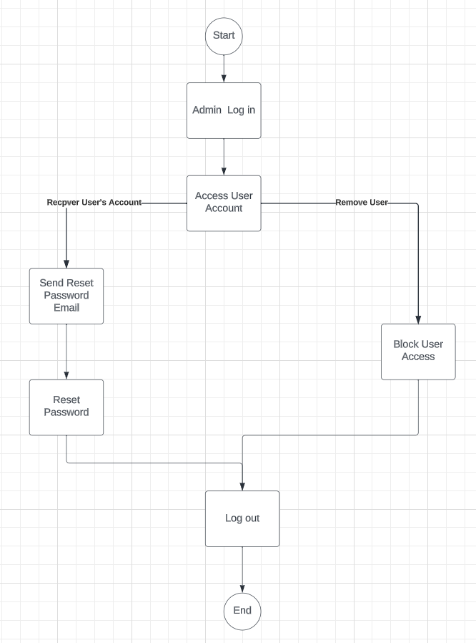
Activity Diagram
Notes:
[Explain your diagram. Which use case are you breaking down? What are the steps for this use case? How did you account for DriverPass’s needs in your design? In your explanation, keep your audience in mind. Avoid the use of technical terms such as “nodes,” “control flows,” and so on.]

Slide 5
Security
Encryption: Implement strong encryption for data protection.
Access Control: Enforce strict user access controls and authentication methods.
Regular Updates: Ensure timely application of security patches and updates.
Multi-Factor Authentication: Use MFA for enhanced user authentication.
Firewalls and Monitoring: Employ firewalls and continuous monitoring for threat detection.
Data Backup: Implement robust backup procedures to prevent data loss.
User Training: Provide regular security training to users.
Vendor Compliance: Ensure third-party vendors comply with security standards.
Incident Response Plan: Establish protocols for responding to security incidents.
Notes:
[How did you consider security in your design? In your explanation, keep your audience in mind by avoiding the use of technical terms.]

Slide 6
System Limitations
Scalability Challenges: Difficulty in scaling up to meet increased user demands.
Internet Dependency: Vulnerability to disruptions due to reliance on internet connectivity.
Compatibility Issues: Possible compatibility problems with certain devices or systems.
Persistent Security Risks: Ongoing susceptibility to emerging threats.
Resource Intensiveness: Certain functions may demand significant computational resources.
Complex Maintenance: Maintenance complexities affecting efficiency.
Cost Considerations: Higher operational costs than anticipated.
Limited Functionality: Lack of certain desired features or functionalities.
Compliance Adjustments: Challenges in staying compliant with evolving regulations.
Potential Downtime: Unforeseen issues leading to occasional system downtime.
Notes:
[What are the limitations of your design? In your explanation, keep your audience in mind by avoiding the use of technical terms.]

